Slide 1
Memory Systems Design
  Introduction: 2 Lectures
    Classification of Memory Technology
    Expanding Memory Width and Size
    Memory and CPU Interfacing
  Address Decoding: 3 Lectures
    Full Address Decoding Techniques
    Partial Address Decoding Techniques
    Block Address Decoding Techniques
©Paul Davies. Not to be copied, used, or revised without explicit written permission from the copyright owner.
This lecture may contain animations and is best viewed as a slide show

Slide 2
What is Address Decoding ?
Address decoding is a simple process that attempts to ‘map’ a memory device so that it responds to a particular range of CPU addresses.
That is, if the CPU issues an address within the designated range for the device, that device alone will respond.
It’s important that only one device in the system respond to any given address. If to devices responded to the same CPU address during a read operation, they could both turn on their data bus output buffers and could blow each up.
Address decoding allows us to partition the memory space of the CPU into smaller blocks that can then be designated as areas for Sram, Dram, Flash etc. and even memory mapped IO devices that respond like memory.
The same techniques allow us to break up a section or block of say Sram into smaller individual banks of Sram.

Slide 3
Example
In a 68000 system with address lines A1-A23 i.e. an address space of 8M Words (or 16M bytes), address decoding might be used to create a 256k byte (128k word) block of Sram allocated to the address range [04 0000 – 07 FFFF].
This in turn could be further broken down into 4 banks of 64k bytes (32kwords) between [04 0000 – 04 FFFF], …. [07 0000 – 07 FFFF] and then constructed from 8 x 64k byte memory chips to occupy the full 256k byte (128k word) address range.
Designing an Address decoder is a straightforward combinatorial design problem, where the circuit produces Chip Select signals to enable individual memory devices based on the addresses currently being issued by the CPU.
However there are many ways to design decoder with different trade offs.

Slide 4
Decoding memory addresses is analogous to decoding telephone numbers
  The telephone exchange is analogous to our address decoder.
  Each telephone number must be unique (within its domain)
  We use a telephone number to uniquely address individual phones.
For example consider dialling the number 001 604 123 4567
  The first 3 digits of the phone number partition the global world phone space into a country.
  The next 3 digits partition the country phone space into a city or region.
  The next 3 digits might partition the city/region phone space into a suburb.
  Finally the remaining 4 digits might partition the suburb space into unique phones with numbers in the range 0000 - 9999.

Slide 5
In a computer system, the same principles of partitioning into domains occurs
In particular, we decode/partition the CPUs total address space such that
  Part of the address issued by the CPU (usually the higher order address lines) is used to partition the total memory space of the CPU into blocks reserved for say Sram, Dram, Flash or Memory Mapped Peripherals.
  Within each block, an additional sub-set of the remaining address lines may be further decoded to select individual Banks of memory, e.g. to partition the Sram area into 4 blocks of 64k Words each.
  Finally, whatever address bits are then left are decoded internally by the memory chip itself to select memory locations or registers within the chip.

Slide 6
Partitioning 64k of 6811’s Memory Space into 4 x 16k and then 8 x 2k banks
Primary Decoder in this case partitions the memory space of the 6811 into 4 equal sized blocks of 16k bytes each
16 Bit Address Bus [A0-A15] from 6811
Unused
[A15, A14]
E
Primary Decoder
PS3 – [C000 – FFFF]
16k Rom
PS2 – [8000 – BFFF]
16k Ram
16k memory block utilises
[A0-A13]
PS1 – [4000 – 7FFF]
16k IO
PS0 – [0000 – 3FFF]
Selects 1 of 4, 16k Partitions for Rom at address 0-3FFF
2k block utilises [A0-A10]
2k Bank 0 = [0000-07FF]
[A0-A10]
Bank 0
(2Kbytes)
Unused
[A11 – A13]
CS
Secondary Decoder partitions the 16k Memory block
[0000 – 3FFF] into 8 banks of 2K bytes
E
Bank select 0
D
e
c
o
d
e
r
Bank 7
(2Kbytes)
2k Bank 7 = [3800-3FFF]
[A0-A10]
CS
Bank select 7
16k Partition Needs 14 Address Lines [A0-A13]

Slide 7
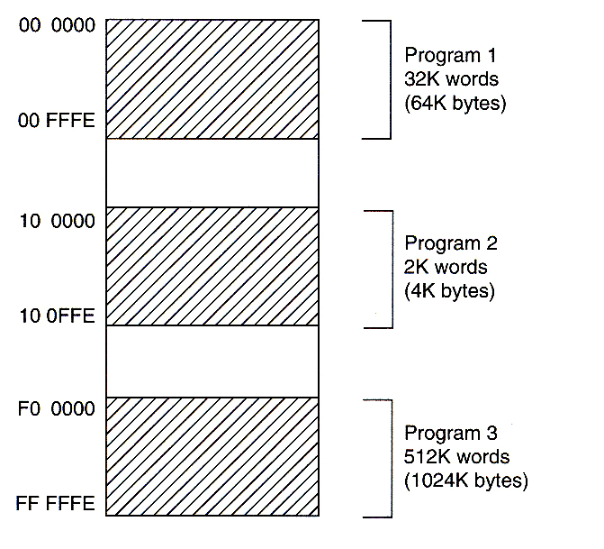
Designing a Memory Map
Memory systems are usually partitioned into blocks of Rom, Ram and Peripherals. (see opposite)
The only constraint for the 68k is that there should be some Rom at say location 0 upwards to hold the reset exception vector table and Boot code (Note some CPUs reserve the top of the memory space for Boot Roms).
Everything else is ‘user definable’. No single memory map is necessarily any better than any other, they are just different.
Some maps are designed to have holes in them to allow for expansion, some are designed with economy in mind, i.e. to use the minimum amount of logic etc. and some are just simply random !!
FF FFFF
ROM
RAM
512k Words
(1Mbyte)
F0 0000
Unused
10 0000
Peripherals
Peripherals
2k Words
(4k bytes)
10 0FFF
Unused
00 FFFF
RAM
ROM
32k Words
(64k bytes)
00 0000
68000 Memory Map Partitioned into 3 Blocks or Rom, Ram, and Peripherals

Slide 8
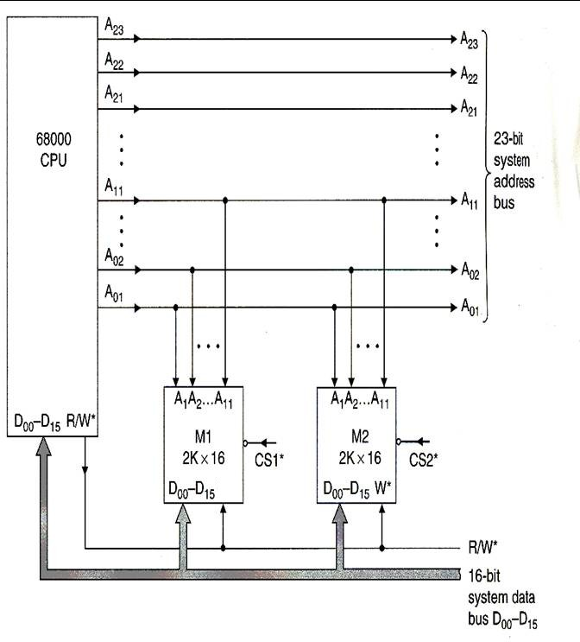
Example Problem
Design an address decoder for a 68000 system with memory devices arranged as follows:
  2K Word Block of Rom: M1
  2K Word Block of Ram: M2
A 2k word (4Kbyte) block will need 11 address lines connected to the lowest address lines issued by the CPU: A1-A11.
Our task is to design a decoder that will generate the chip selects (CS1* and CS2*) for each block so that only one block responds to each address.
We get to choose where to position the block in the memory map. That is, what range of CPU addresses the block will respond to.
Rom
Ram
M1 = Block of Rom
M2 = Block of Ram

Slide 9
Full Address Decoding Techniques

Slide 10
A system employs FULL address decoding, when the decoder circuit utilises all the unused address lines that are not directly connected to the memory chips.
In our previous example, a full address decoder would decode A12-A23 (for original 68000, A12-A31 for the soft core 68k used in this course).
Let’s design a decoder to place :-
  Rom (M1) at address [00 0000 – 00 0FFF] = 4KB
  Ram (M2) at address [00 1000 – 00 1FFF] = 4KB
This arrangement will give us a total of 4KWords (8KB) of contiguous memory with no gaps and no overlaps and thus the memory map will look like that shown opposite.
Memory Map
FF FFFF
Unused
00 2000
00 1FFF
Ram (M2)
4KB
00 1000
00 0FFF
Rom (M1)
4KB
00 0000

Slide 11
How do we design the address decoder circuit to realise this map?
Step1: Create an address table with all CPU address lines listed as columns. In the case of the (original) 68000 this will be A23-A1.
Step 2: Create a Row entry for each memory block in your memory map that you are designing a chip-select signal for: In this case M1 and M2.
Step 3: Decide how many of the CPU address lines will connect directly to the memory blocks and place an ‘X’ meaning “don’t care” under those address lines in the table because those address lines will be decoded by the memory chips/blocks themselves.
Because we are using 2K word blocks, each Rom/Ram block will utilise 11 addresses lines (2¹¹ = 2048), leaving A12-A23 to be decoded.
Note no A0 on 68k as it outputs word addresses
Address 23 22 21 20 19 18 17 16 15 14 13 12 11 10 9 8 7 6 5 4 3 2 1
M1 x x x x x x x x x x x Rom[000000-000FFF]
M2 x x x x x x x x x x x Ram[001000-001FFF]

Slide 12
Step 4: Use the remaining address bits in the table to choose the combination of 0’s and 1’s on the address lines that will select the device at the locations required, taking care to make sure no two devices ever respond to the same address.
Our full address decoder design thus decodes [A12 - A23]
Notice how a difference in A12 is what effectively differentiates an address intended for M1, from M2. Thus
M1 is addressed when [A23 - A13] = 0 and [A12] = 0
M2 is addressed when [A23 - A13] = 0 and [A12] = 1
These combinations of address lines are mutually exclusive conditions thus only one device can be selected at a time.
Note no A0 on 68k as it outputs word addresses
Address 23 22 21 20 19 18 17 16 15 14 13 12 11 10 9 8 7 6 5 4 3 2 1
M1 0 0 0 0 0 0 0 0 0 0 0 0 x x x x x x x x x x x Rom[000000-000FFF]
M2 0 0 0 0 0 0 0 0 0 0 0 1 x x x x x x x x x x x Ram[001000-001FFF]
  M1 = A23 + A22 + A21 + …. + A12
  M2 = A23 + A22 + A21 + …. + (!A12)
Active low ‘memory select’ signals formed in this example by “OR”ing unused address lines

Slide 13
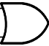

M2 Block Decoder and Memory.
M1 would be similar except there would be no “not” gate on A12
A23
Note DTACK* and BERR* generator circuits dealt with later
A22
A21
A20
CS valid in Range [00 1000 - 00 1FFF]
A19
A18
M2
A17
A16
A15
A14
R/W
A13
A12
OE
OE
WE
WE
LDS
CS
UDS
CS
Note: Not gate “bubble” on A12
2k x 8
2k x 8
D0-D7
D0-D7
D8-D15
D0-D7
A0-A10
A0-A10
A0-A10 on Memory chip connected to A1 – A11 on CPU
A1-A11
68000 has no A0. 11 Address lines give 2k word locations each of which is 16 bits or 2 bytes
Two 2k byte devices working in parallel to give 2k words (or 4K bytes)

Slide 14
A More Practical Example
A 68000 system requires the following arrangement of Rom, Ram and Peripheral chips:
    10K word block of Rom arranged as
      2K words (Rom1)
      8K words (Rom2)
    2K word block of Ram (Ram1)
    2 Individual words for a 16 bit Peripheral #1 (Peri1)
    2 Individual words for a 16 bit Peripheral #2 (Peri2)
You are free to assign any addresses you like with the exception of Rom1 which must reside at a base addresses of 0.
Design a full address decoder to implement this memory map.

Slide 15
Step 1: Map each chip to an address space in the memory map of the system. The only constraint here is that Rom1 should reside at base address 0.
The choice of other block addresses is fairly arbitrary so the memory map below has been chosen.
  Rom1 = [00 0000 - 00 0FFF] 2 K Words ( 4 KB range)
  Ram1 = [00 1000 - 00 1FFF] 2 K Words ( 4 KB range)
  Rom2 = [00 4000 - 00 7FFF] 8 K Words (16 KB range)
  Peri1 = [00 8000 - 00 8003] 2 Words ( 4 byte range)
  Peri2 = [00 8004 - 00 8007] 2 Words ( 4 byte range)
These addresses were carefully chosen so that there is no overlap or sharing of addresses between the blocks. Many other memory maps could have been chosen.
For example, Rom2 could have been chosen to be contiguous with Rom 1 i.e. from address [00 1000 - 00 8FFF] but it wasn’t because the decoder for an 8k block is easier to design if we assign the block a start address corresponding to that of a natural 8k boundary in the memory i.e. it doesn’t straddle an 8k boundary
We would have needed 4 separate 2k decoders OR’d together if we made Rom2 start at a 2k boundary).
This is why Rom2 was chosen to start at address [00 4000].

Slide 16
Step 2: Decide how many Address lines each block will require governed by its size.
  Rom1 is a 2K word block requiring 11 address lines (i.e. 2¹¹ = 2048).
  Ram1 is also a 2K word block also requiring 11 address lines.
  Rom2 is an 8K word block requiring 13 address lines (i.e. 2¹³ = 8192).
  Peri1 is a 2 word peripheral requiring 1 address line.
  Peri2 is a 2 word peripheral requiring 1 address line.

Slide 17
Step 3: Create an address table for your memory map. Place an ‘x’ in the row entry for each chip beneath the address lines that connect directly to the chip.
From this address table we determine which combination of 0’s and 1’s on the unused address lines for each chip are used by the decoder to provide a chip select signal.
We can thus see that the Boolean expression for the active low block select signals is given as
  Rom1 = A23 + A22 + A21 + …. + A12
  Ram1 = A23 + A22 + A21 + …. + (!A12)
  Rom2 = A23 + A22 + A21 + …. + A15 + (!A14)
  Peri1 = A23 + A22 + A21 + …. + A16 + (!A15) + A14 + A13 + …. + A3 + A2
  Peri2 = A23 + A22 + A21 + …. + A16 + (!A15) + A14 + A13 + …. + A3 + (!A2)
Note no A0, as LDS* and UDS* select individual bytes within a word
Address 23 22 21 20 19 18 17 16 15 14 13 12 11 10 9 8 7 6 5 4 3 2 1
0 0 0 0 0 0 0 0 0 0 0 0 x x x x x x x x x x x Rom1
0 0 0 0 0 0 0 0 0 0 0 1 x x x x x x x x x x x Ram1
0 0 0 0 0 0 0 0 0 1 x x x x x x x x x x x x x Rom2
0 0 0 0 0 0 0 0 1 0 0 0 0 0 0 0 0 0 0 0 0 0 x Peri1
0 0 0 0 0 0 0 0 1 0 0 0 0 0 0 0 0 0 0 0 0 1 x Peri2
000000-000FFF
001000-001FFF
004000-007FFF
008000-008003
008004-008007
Obviously we would turn these Boolean Expressions into Verilog of VHDL or even a schematic diagram in Quartus

